Slide 1
Organization and Organizational Structure

Slide 2
Introduction
Organization is a social group in which distributes tasks for a collective goal.
Organization structure refers to the framework that outlines how activities are coordinated, controlled, and delegated within an organization. It defines the relationships between different roles, departments, and levels of authority.

Slide 3
Introduction
The following common types of organization find a place in the structure of internal organization.
Line, Military or scalar organisation
Line and staff organization
Functional organisation
Committee organisation
Project organisation
Matrix organization

Slide 4
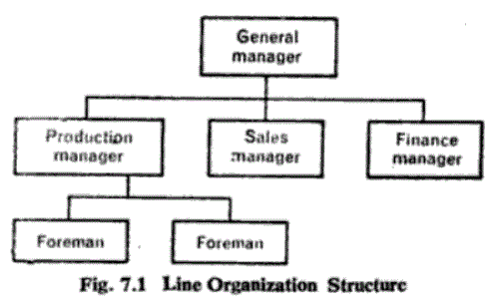
1. Line Organisation
Line organisation is the simple and oldest type of organisation followed in an organization. It is characteristics by direct vertical authority-responsibility-accountability relationship.

Slide 5
Line Organisation
This type of organization is followed in the army on the same pattern. So, it is called military organization. Under type of organization, the line of authority flows from the top to bottom vertically. So it is called line organization.

Slide 6
Characteristics of line organisation
It consists of direct vertical relationships.
Authority flows from top-level to bottom level.
Departmental heads are given full freedom to control their departments.
Each member knows from whom he would get orders and to whom he should give his orders.

Slide 7
Suitability
This type of organisation is suitable to small size business units.
Where the activities are of routine nature or machine based.
If the business activities are service mined.
Where the number of persons working is small
The business operation is simple in nature.
A business unit which has straight methods of operations.

Slide 8
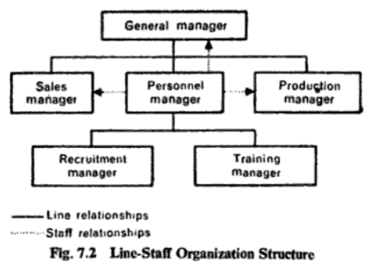
2. Line and staff organisation
It is called secondary functional differentiation at horizontal level.
The line officers have authority to take decisions and implement them to achieve the objectives of the organisation.
The line officers may be assisted by the staff officers while framing the policies and plans and taking decisions organisation.

Slide 9
Line and staff organisation
The authority flows from top level to the lower level of the organisation through the line officers while the staff officers attached to the various departments advise the departments.
The staff officers are not in a position to compel the line officers to follow the advice by them. Each department is headed by a line officer who exercises full authority regarding the planning.

Slide 10
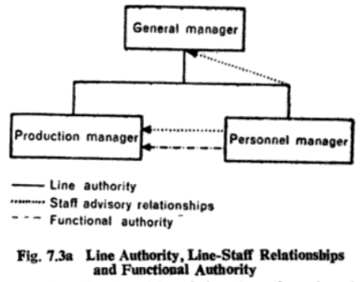
Functional organization
Staff specialist renders advise and service and also exercises command of authority of a specific nature in relation to him.
Functional authority is not authority over someone but over something.

Slide 11
Functional organisation
The need for functional organisation arises out of:
The complexity of modern and large-scale organisation
A desire to use the specialization in full and;
To avoid the work-load of line managers with complex problems and decision-making

Slide 12
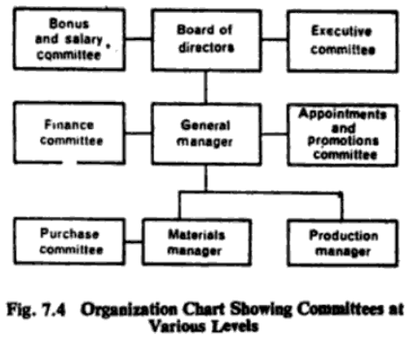
Committee organisation
“A Committee as a group of persons either appointed or elected who are to meet for the purpose of considering matters assigned it”
Types of committee
Permanent committee
Ad-hoc committee

Slide 13



Recommendations for efficient functioning of a committee
Size of the committee
Clear Objective
Preparation for a meeting
Selection of meeting
Role of
chairman
Committee
Follow up
Evolution
Role of
committee
Selection of
subject matter

Slide 14
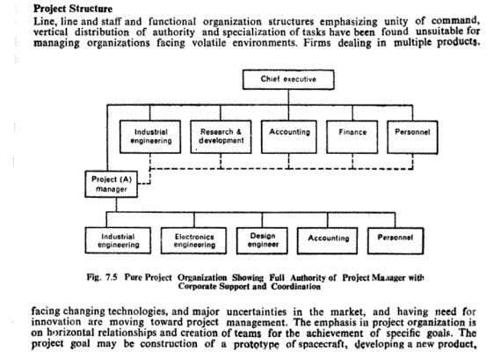
Project organisation

Slide 15
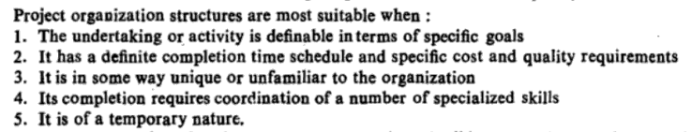
Project organisation

Slide 16
Matrix organisation
o “Any organisation that employs a multiple command structure but also related support mechanisms and an associated organizational culture and behavior pattern”
The matrix organisation may be followed where a large of small projects have to be managed.

Slide 17
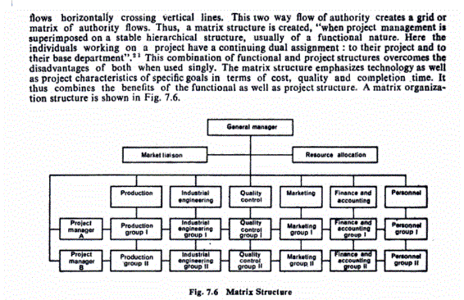
Matrix organisation

